Slide 1
Creating Accessible Documents & Slides:
Microsoft, Google, Canva
Terrill Thompson, Gaby de Jongh, & Alaina Foust
UW-IT Accessible Technology Services
University of Washington
https://uw.edu/accesstech

Slide 2

A follow-up to our original presentation
Microsoft vs Google: Presented at Accessing Higher Ground 2023 & CSUN 2024

Slide 3

Updated info, plus introducing a new character (Canva)

Slide 4
Our Goals
Share our Top Ten Techniques for authoring accessible documents and slides.
Share which authoring tools support them
  Microsoft Word and PowerPoint
  Google Docs and Slides
  Canva
Document how well accessibility survives if content is exported to PDF.

Slide 5
Screen Reader Support
Many of our Top Ten Techniques are specifically intended to benefit screen reader users. When we originally gave this presentation, we conducted extensive screen reader testing . Our takeaways:
Our Top Ten Techniques are widely known best practices. Screen readers should support them.
There are many variations in whether and how screen readers support these techniques. This is constantly changing and is more than we can track.
If you discover a screen reader failure to support any of these techniques, please file a bug with the screen reader maker.

Slide 6
Grackle plugin for Google
Regarding Google, this presentation focuses on the native capabilities of Google Docs and Slides. In some cases, where Google falls short, Grackle Workspace might provide a solution.
Adds an accessibility checker
Adds the ability to export to tagged PDF
More info at grackledocs.com

Slide 7
Technique #1
Alt Text

Slide 8
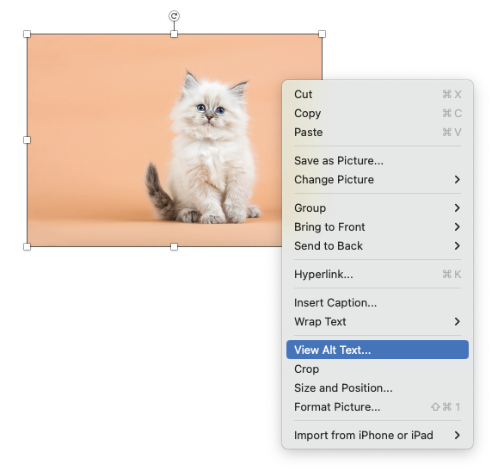
Alt Text in Microsoft Word & PowerPoint (desktop)
Right click image to show context menu
Select “View Alt Text” from the menu

Slide 9
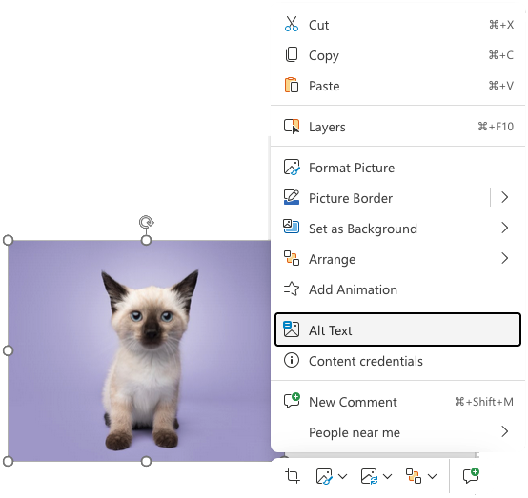
Alt Text in PowerPoint for the Web
In PowerPoint for the Web, right click the image and choose ‘Alt Text’ from the context menu.

Slide 10
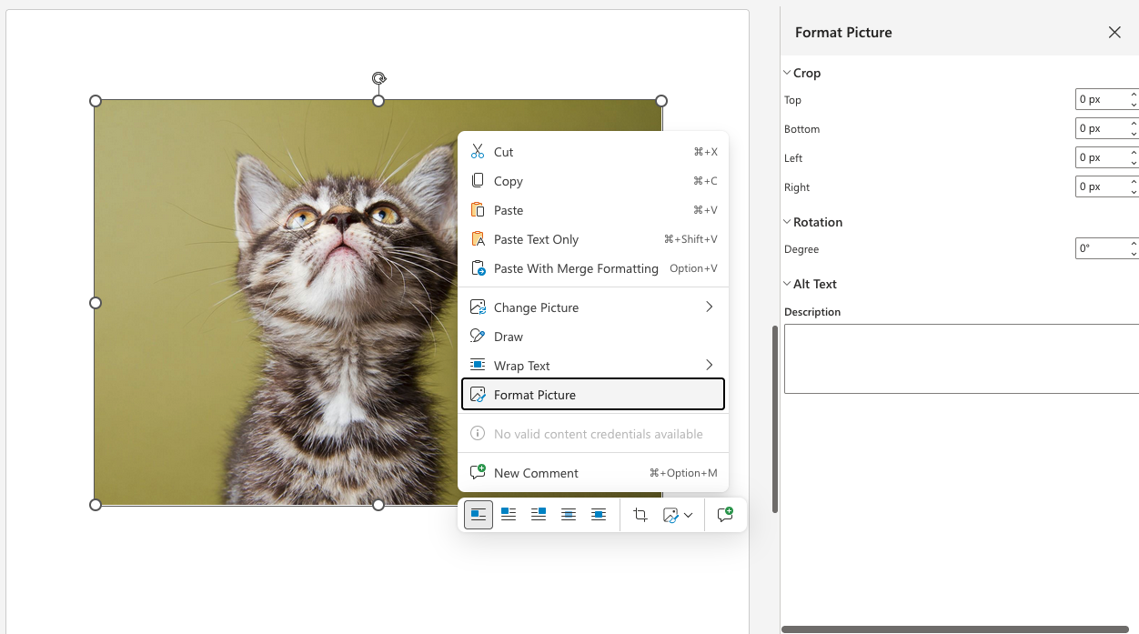
Alt Text in Word for the Web
In Word for the Web, there is no option to add or edit alt text from the context menu. This critical option is hidden by default. Users must choose ‘Format Picture.’

Slide 11
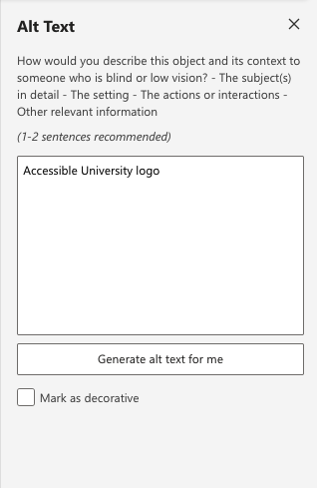
Alt Text Panel (Word desktop, PPT desktop & web)
Enter alt text in description field
Images that are purely decorative, select “Mark as decorative”
“Generate a description for me” automatically creates a description, but use with caution (or not at all)

Slide 12
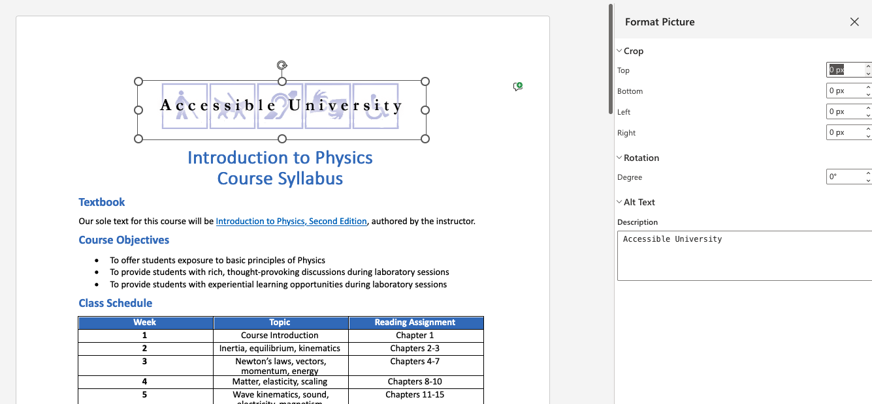
Format Picture Panel (Word forWeb)
Add Alt text in "Description" field
Can’t mark images as decorative

Slide 13
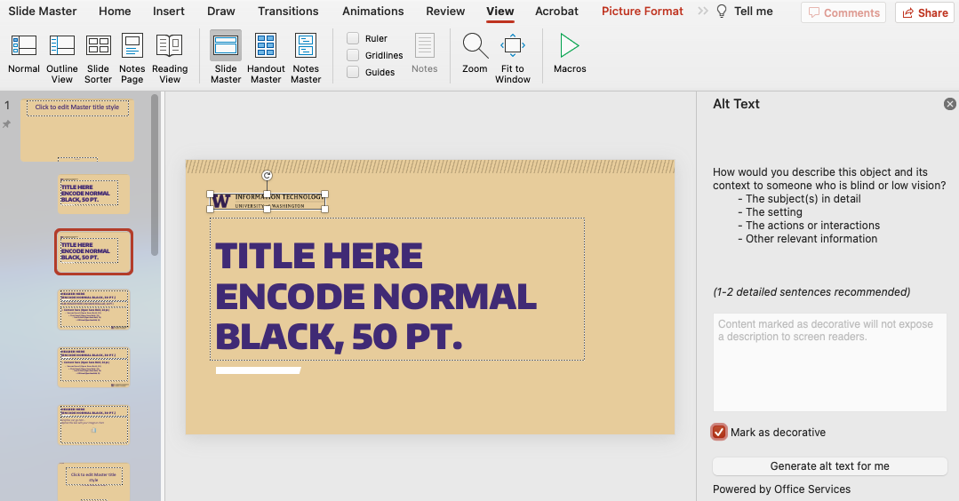
Background images on Master Slide in PowerPoint Desktop only
Select the "View" tab, choose "Slide Master"
  Select image, right click > Alt text
  Check "Mark as decorative" checkbox

Slide 14
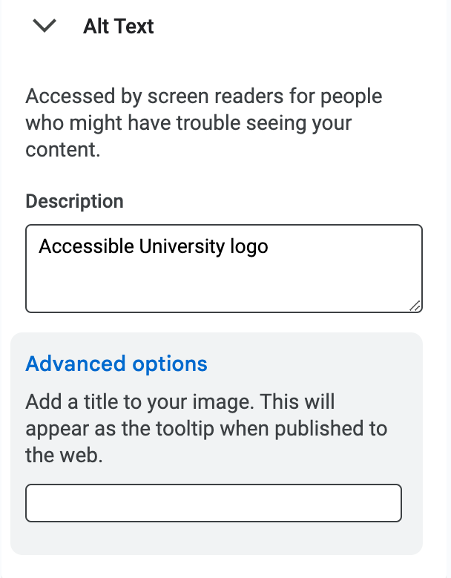
Alt Text in Google Docs & Google Slides
Right click image
  Select “Alt text” from the context menu
  Add Alt text in "Description" field
Optionally, add “Title” but:
  Know that “Title” will not survive if document is exported to Word, PPT, PDF
Can’t mark images as decorative

Slide 15
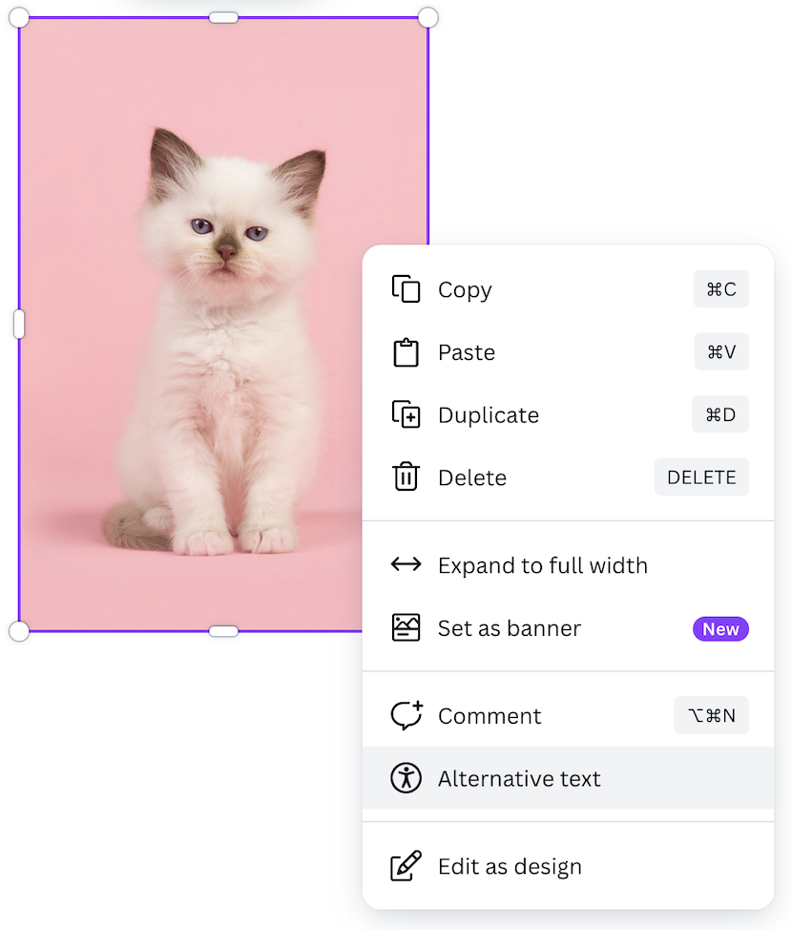
Alt Text in Canva
Right click image to show context menu
Select “Alternative Text” from the menu

Slide 16
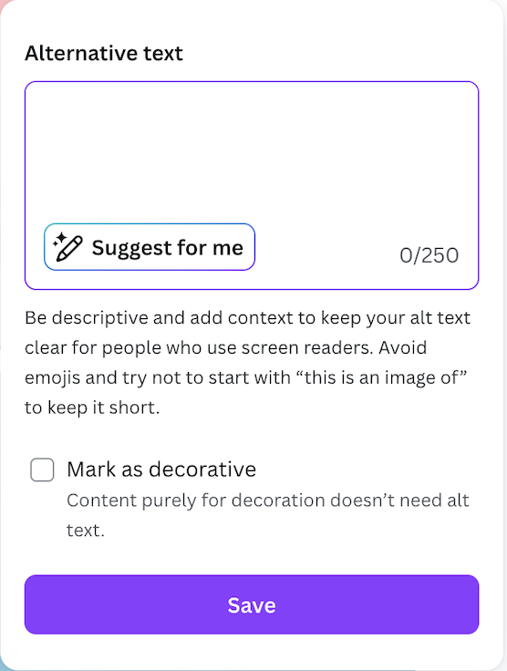
Canva Alt Text Panel
Images that are purely decorative, select “Mark as decorative” checkbox
“Suggest for me” automatically creates a description, but use with caution

Slide 17
Technique #1: Converting to PDF
New! Google Docs now supports tagged PDF.
  Google Slides does not, but Grackle fills this gap.
Canva:
  Alt text for images is passed to PDF.
  Images marked as decorative are not properly tagged in PDFs (they are not artifacted from the tag tree). This is a known bug and should be fixed soon.
Microsoft Office
  There are many ways to export to PDF.
  All methods result in similar output.
  Look for a checkbox or radio button to enable tags and be sure it’s checked!

Slide 18
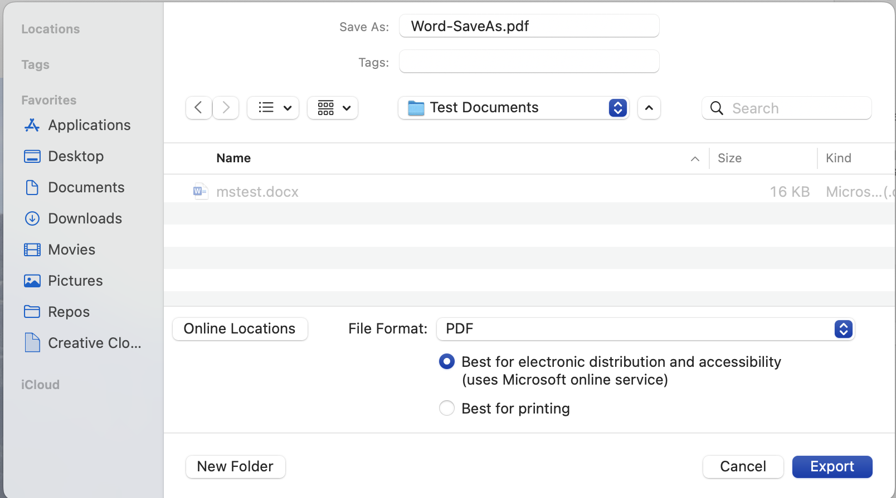
Save As… PDF (Mac)

Slide 19
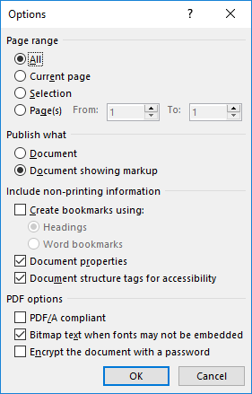
Export > PDF
In “Options”, be sure “Document structure tags for accessibility” is checked
If you chose “Minimize size” (outside of the Options dialog), that will uncheck the above checkbox. Be sure to check it back on.

Slide 20
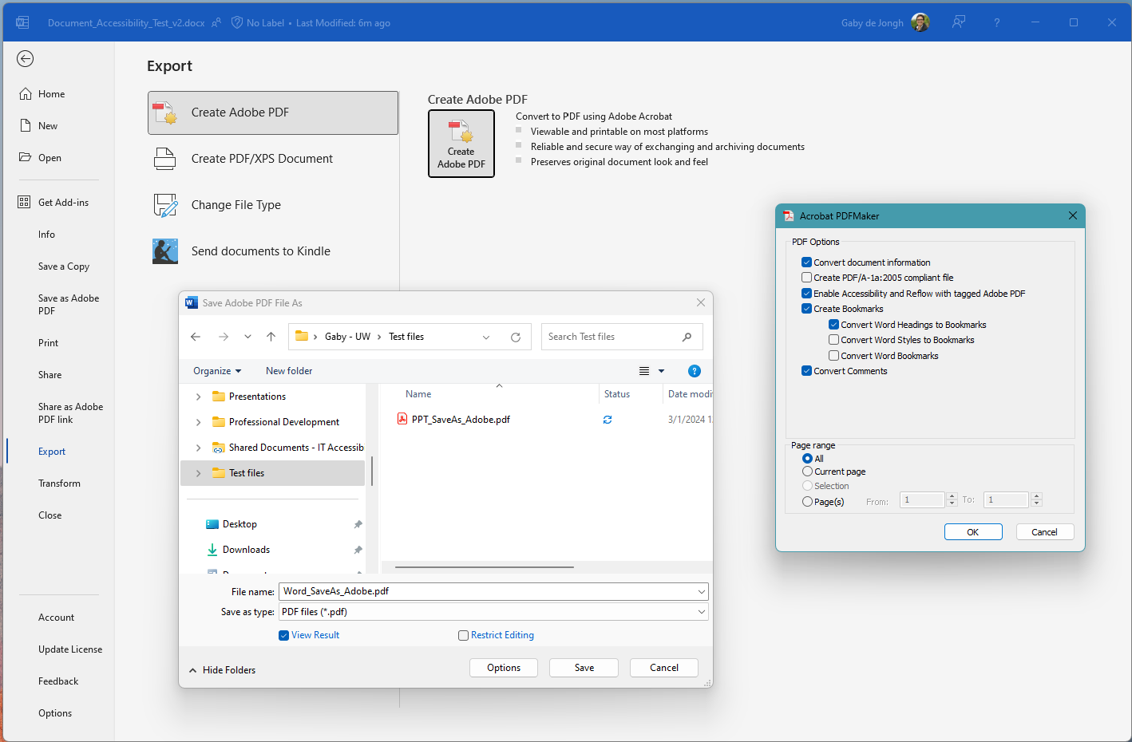
Export > Create Adobe PDF (PDFMaker)

Slide 21
Technique #2
Complex Images + Alt Text

Slide 22
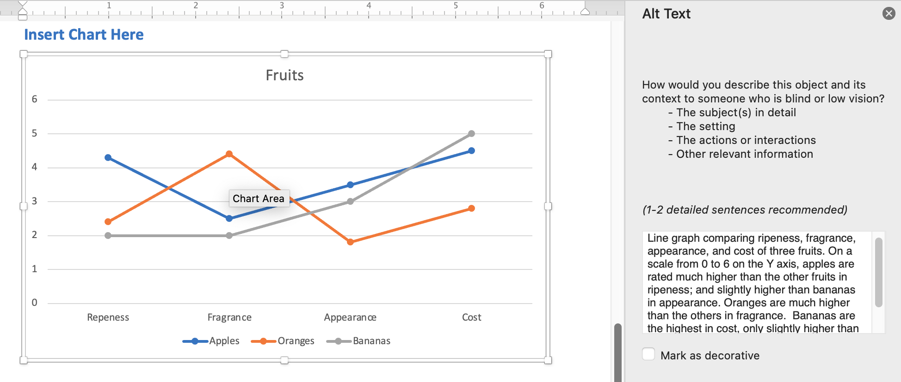
Complex images in Word & PowerPoint – Charts and Graphs
Select object ensuring entire chart (not individual components) is outlined
Word & PowerPoint desktop:
  Right click, select "View Alt text" from context menu
Word & PowerPoint for the Web:
  Adding charts or graphs is not supported

Slide 23
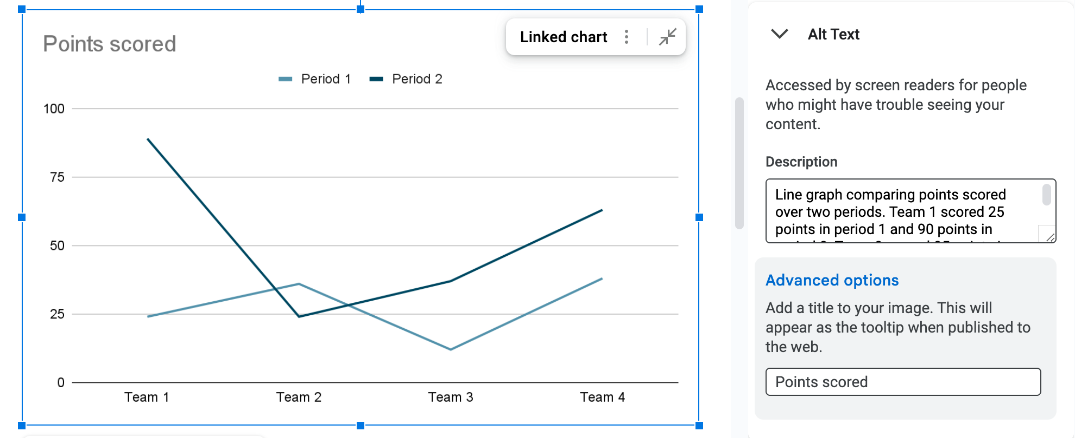
Complex images in Google (Charts, Graphs, Diagrams)
Select object ensuring entire chart is outlined
Google Docs & Slides:
  Right click, select "Alt text" from context menu
  Add Alt Text in "Description" field (Title is optional)

Slide 24
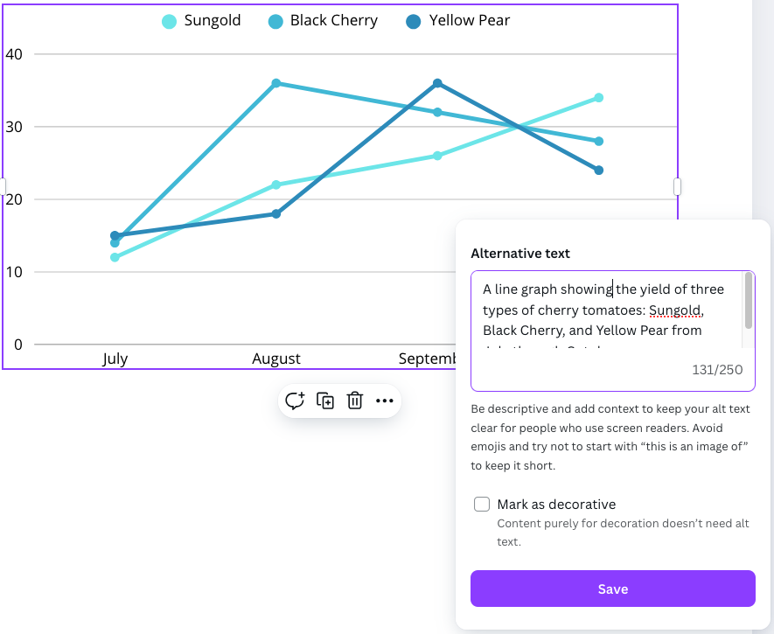
Complex images in Canva (Tables & Charts)
Select object ensuring entire table or chart is outlined
Canva Docs & Slides:
  Right click, select "Alternative text" from context menu
  Add Alt Text in ”Alternative text" field

Slide 25
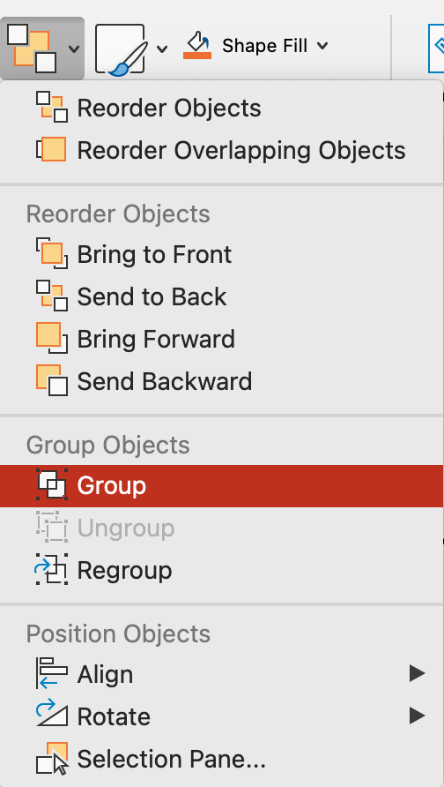
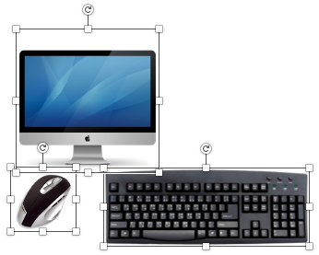
Complex images in PowerPoint - Grouping
Select all images in the group
  From the Home ribbon choose "Arrange" drop down and select "Group"
Then provide alt text for the Group

Slide 26
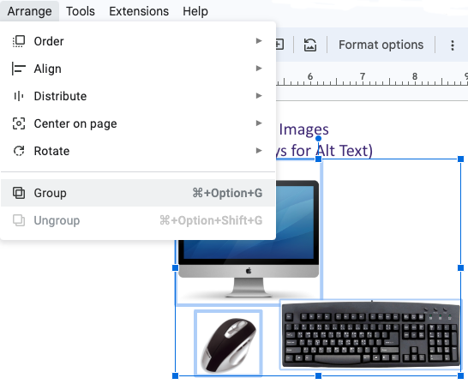
Complex images in Google Slides – Grouping
Select all images in the group
  Choose "Arrange" from the menu and choose "Group"
IMPORTANT! It is not possible to add Alt text to a group in Google

Slide 27
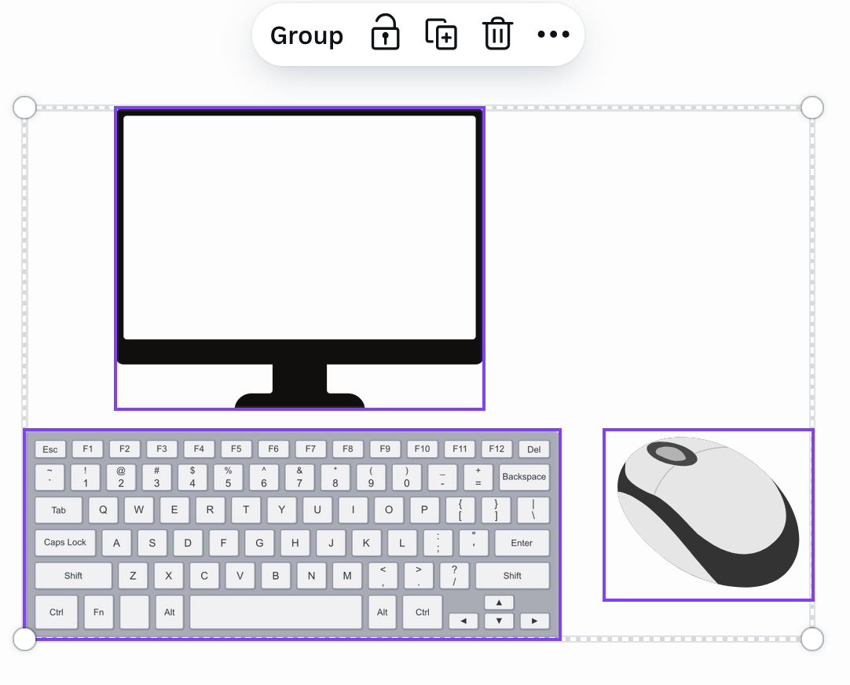
Complex images in Canva Presentations – Grouping
While images can be grouped in Canva presentations, a group cannot be given alternative text.

Slide 28
Technique #2: Results after Export from Word or PowerPoint to PDF
When exporting from the Web or Mac, complex images and alt text survive
Bug when exporting from Windows desktop (filed Sept. 15, 2025)
  If charts or graphs are included in Word or PPT, they do not survive and are artifacted from the tag tree
  If diagrams are included in Word, regardless if alt text was or was not included in the native document, the alt text does not survive and is replaced with scripted, nonsense text

Slide 29
Technique #3
Headings & Slide Titles

Slide 30
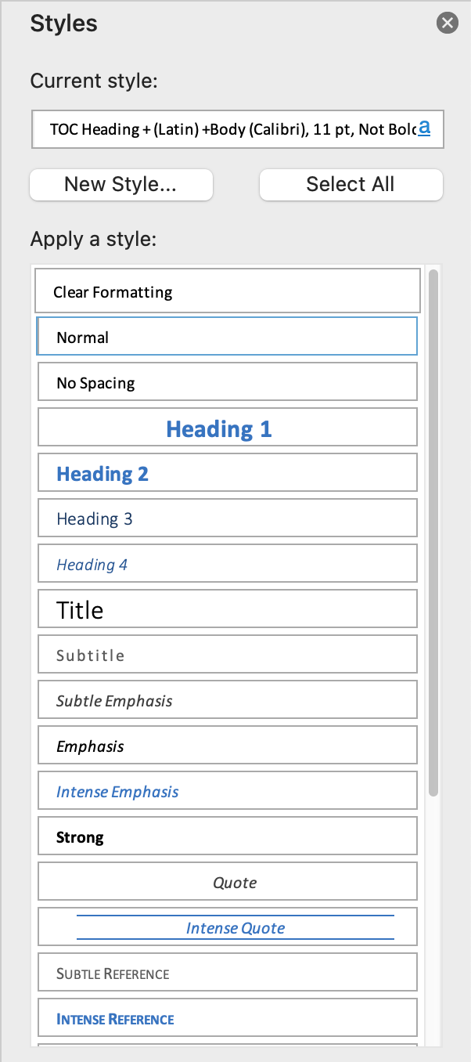
Headings in Word
Use Heading Styles from Home ribbon
  Making text big and bold does not make it a heading

Slide 31
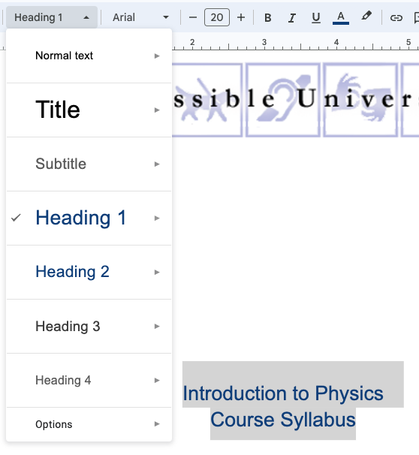
Headings in Google Docs
From the menu bar
  Select the proper Style from the Rich Text Editor drop down

Slide 32
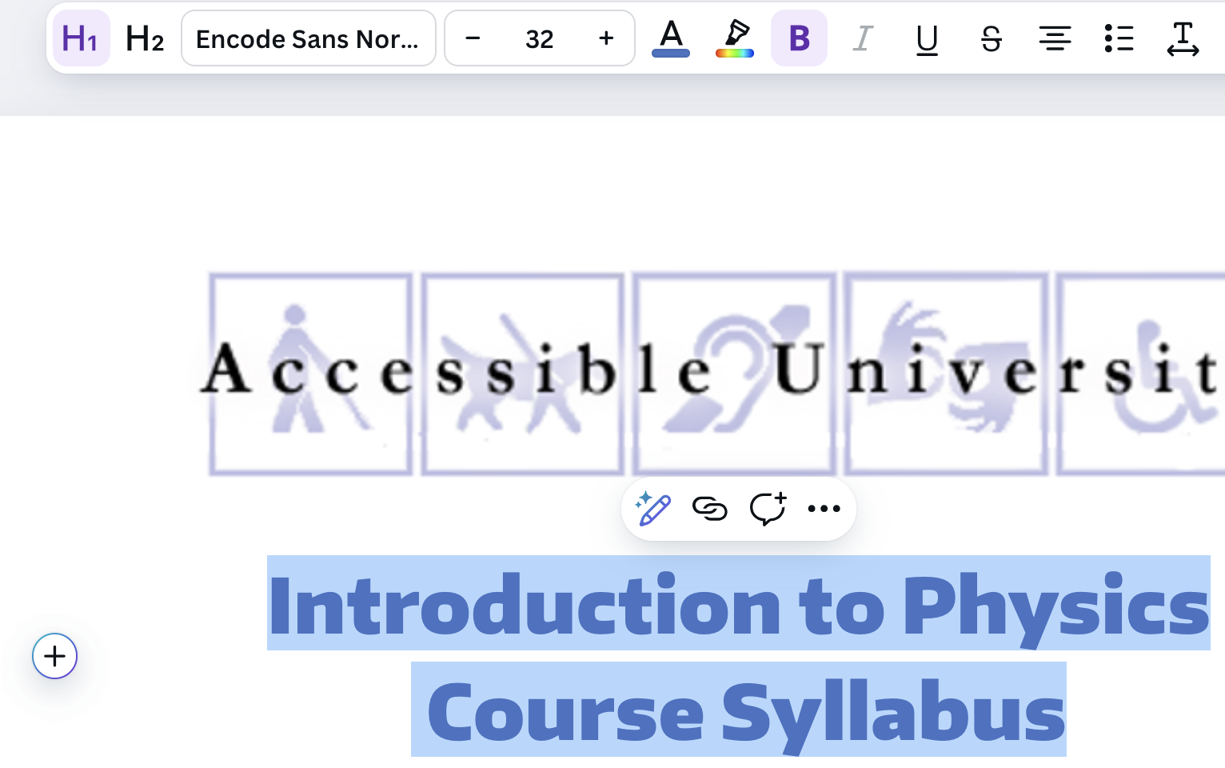

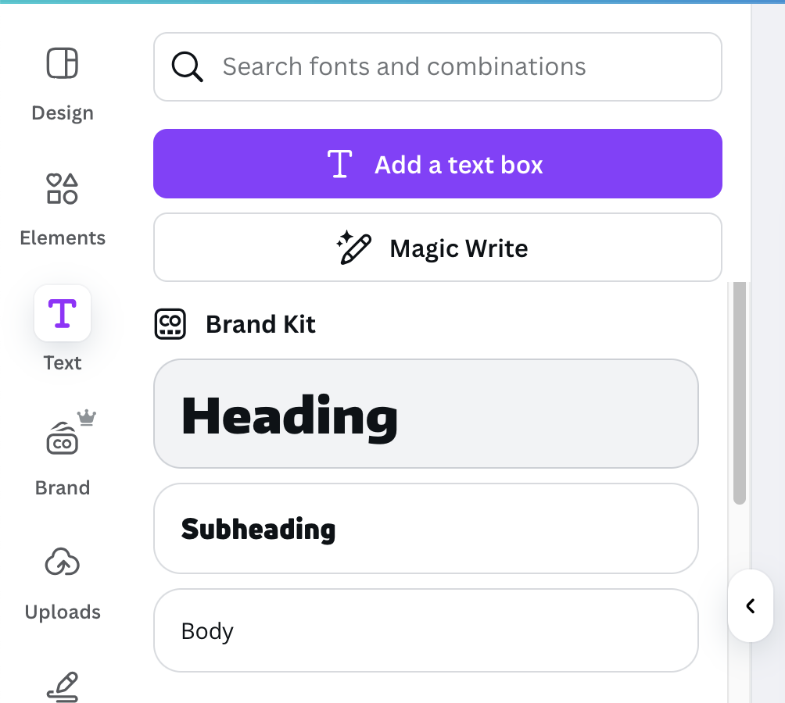
Headings in Canva - Today
Currently, “headings” created in Canva are mainly text styles and should not be relied on to provide structure.
From the menu bar
  Select the proper Style from the menu bar
  Note: Changing styles (besides color) will result in the text no longer displaying as a heading in the menu bar
From the side panel:
  Select Text then Heading or Subheading

Slide 33
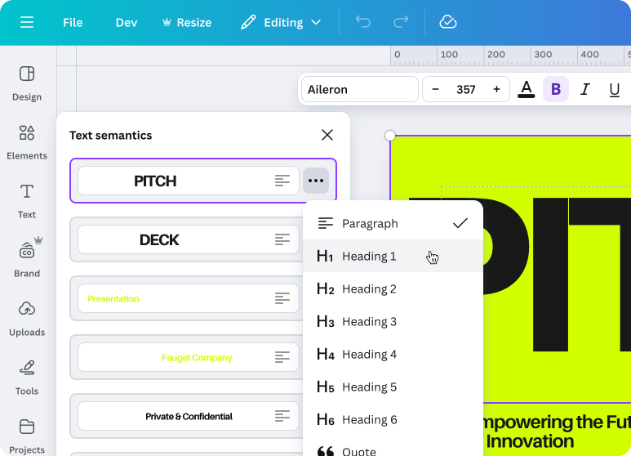
Headings in Canva – Upcoming
Coming Soon! Text Semantics
  Paragraph, H1 through H6, and more will be available soon

Slide 34
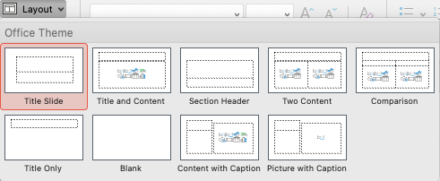
Slide Titles in PowerPoint & Google Slides
Slide titles act as headings
Every slide must have a unique slide title
Use Templates and built-in Layouts

Slide 35
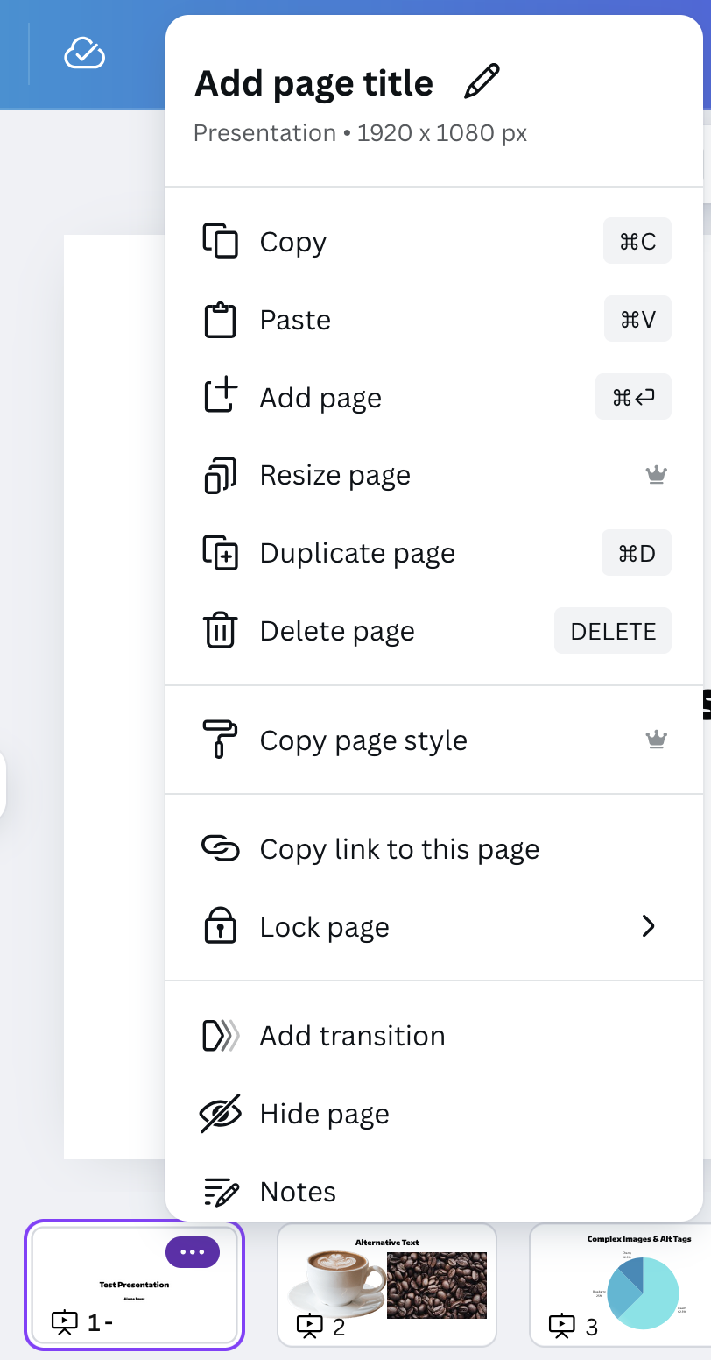
Slide Titles in Canva
Page titles can be added to slides in Canva presentations, but they are only for reference within Canva. Page titles do not survive exporting to PowerPoint or PDF.

Slide 36
Technique #3: Results after Export (Headings)
Headings export as expected from Word to PDF.
Headings export as expected from Google Docs to PDF.
In Canva, content exported to PDF may contain headings, but these might not be the headings you expected. (This is a known issue and will be addressed in a subsequent release).

Slide 37
Technique #3: Results after Export (Slide Titles)
When exporting from PowerPoint to PDF:
  Slide titles are exported as <H1> from the “Title Slide” layout within the template
  Slide titles are exported as <H2> from all content slide layouts within the template
Google Slides does not support tagged PDF.
When exporting from Canva presentations to PowerPoint:
  Slides do not have titles (they fail the PowerPoint accessibility check).

Slide 38
Technique #4
Lists

Slide 39
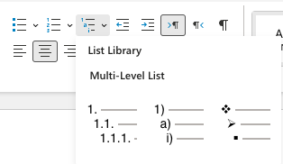
Lists in Word & PowerPoint
From the Home ribbon, choose Bulleted, Numbered, or Multilevel

Slide 40
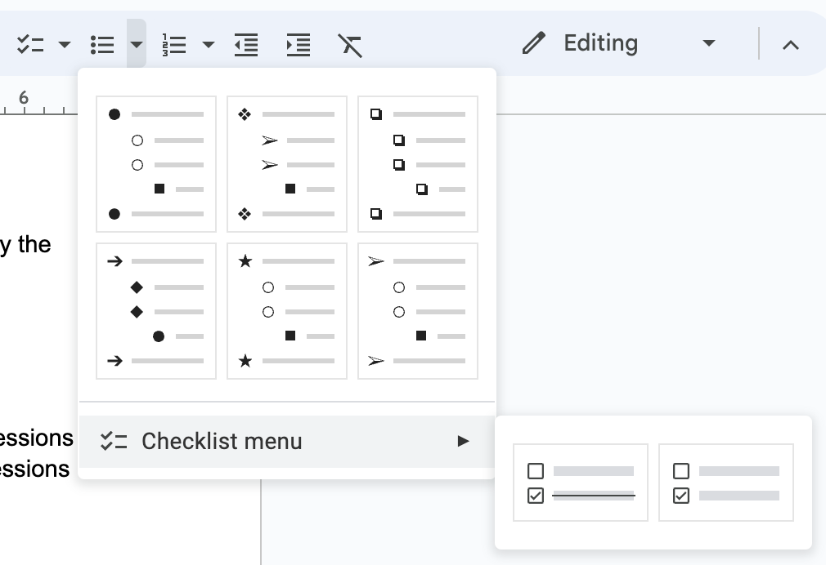
Lists in Google Docs & Slides
From the menu bar select
  checklist
  bulleted list
  numbered list

Slide 41



Lists in Canva
From the menu bar, click to select
  One click: Bulleted list
  Two clicks: Numbered list
  Three clicks: List of checkboxes
    Note: Checkbox inputs are not keyboard accessible

Slide 42
Technique #4: Results after Export
From Word and PowerPoint to PDF:
  Lists are tagged appropriately as lists.
  The PDF spec only includes an <L> tag, not <UL> or <OL>.
From Google Docs to PDF:
  Lists are tagged appropriately as lists.
From Canva to PDF:
  Lists are tagged appropriately as lists.

Slide 43
Technique #5
Tables

Slide 44
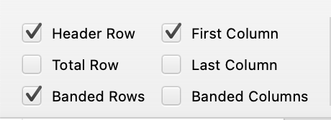
Tables in Word & PowerPoint
Simple tables can be made accessible by defining the table header(s)
  Table Design tab, select the proper row/column option(s)
  Check “Header Row” for column headers
  Check “First Column” for row headers
  “Banded Rows” is for visual purposes only
Complex tables should be simplified for clarity

Slide 45
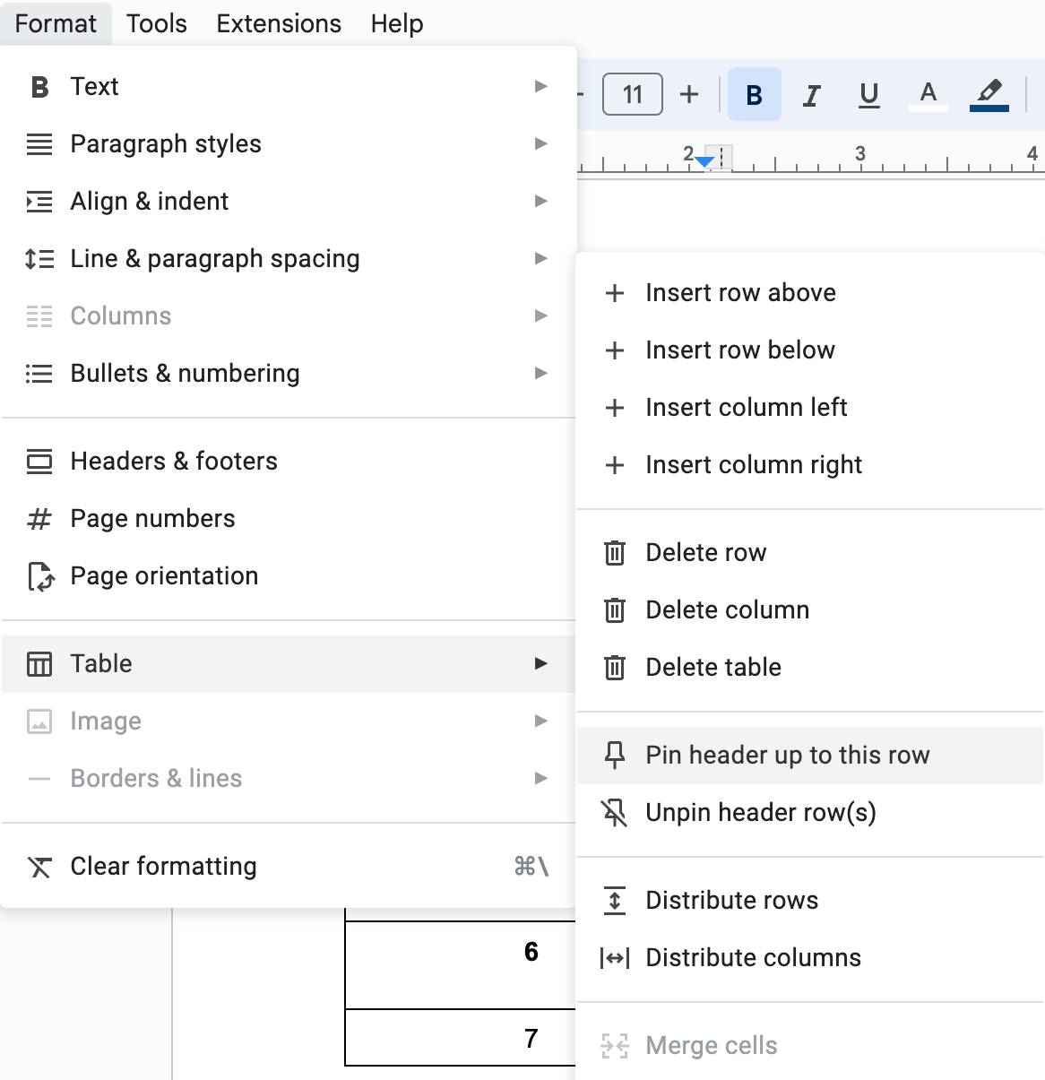
Tables in Google Docs
Select top row of table
  From the menu bar choose "Format," then "Table" > "Pin header up to this row"
In Google Slides it is not possible to pin a header row in a table

Slide 46
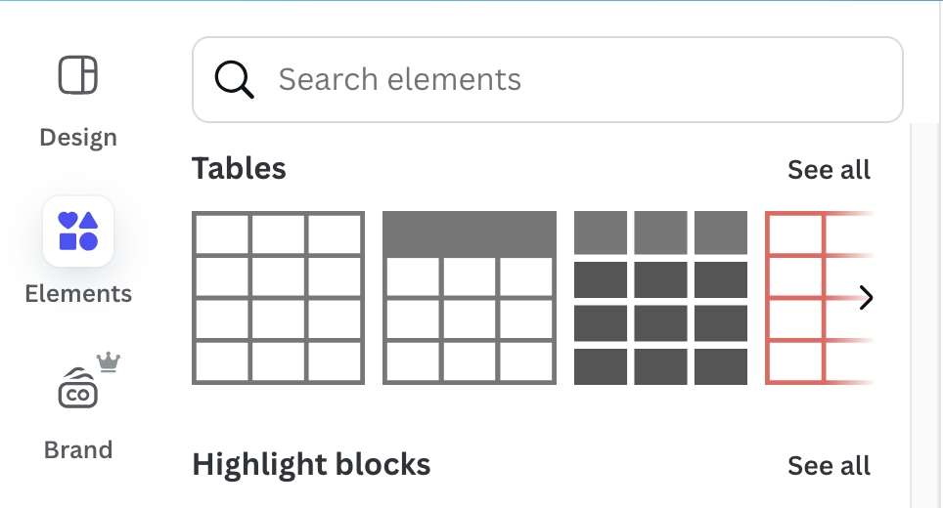
Tables in Canva
Create a table by selecting a table in the Elements option in the side panel.
It is not possible to mark header cells or pin a header row.

Slide 47
Technique #5: Results after Export
In Word or PowerPoint:
  If “Header Row” and/or “First Column” are checked, simple tables are properly tagged in PDF.
  Word and PowerPoint have no mechanism for marking up complex tables. These will need to be tagged in PDF after export.
In Google Docs:
  Tables, including column headers, are properly tagged in PDF.
In Canva:
  Tables do not survive. The table itself, each row, and each cell is coded with <NonStruct> tags. Table content is accessible to screen reader users, but without any table structure.

Slide 48
Technique #6
Links

Slide 49
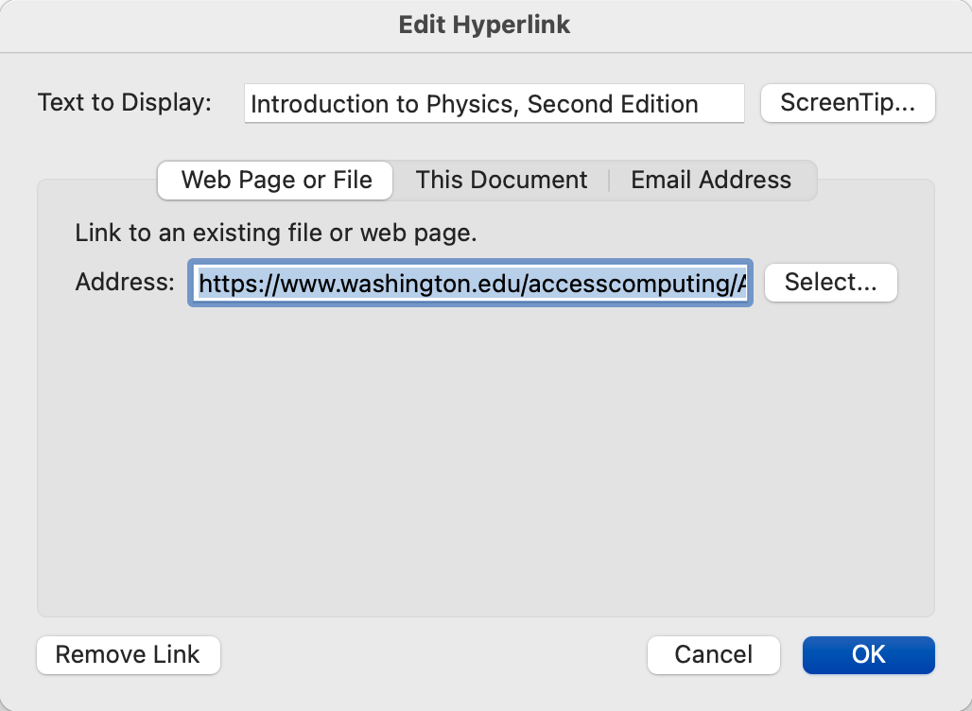
Links in Word, PowerPoint, Google Docs & Slides
Select text, then right click and select “Hyperlink” from context menu
Enter URL in Address field

Slide 50

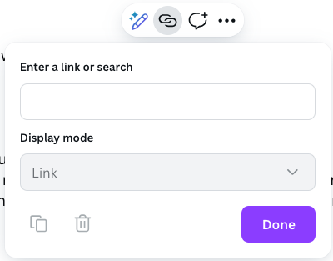
Links in Canva
Select text, then select “Link” from context menu
Enter URL in “Enter a link or search” field

Slide 51
Technique #6: Results after Export
In Word and PowerPoint:
  Links are exported properly to PDF.
In Google Docs:
  Links are exported properly to PDF.
In Canva
  Links are exported properly to PDF.

Slide 52
Technique #7
Document Title

Slide 53
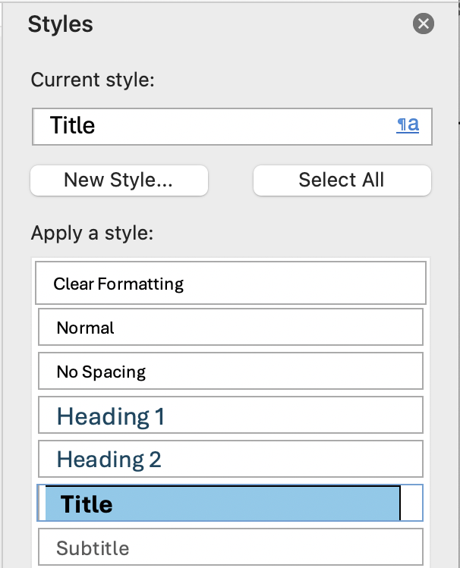
Document Title in Word & PowerPoint
Office Desktop apps
  In Windows:
  File > Info > Show All Properties
  In MacOS:
  File > Properties > Summary tab
Title style is not the same as Document Title
  Title styles are just paragraphs <P> when exported to PDF
In Word & PowerPoint for the Web, the file name appears in an editable field in the upper left. This is used in a <title> element.

Slide 54
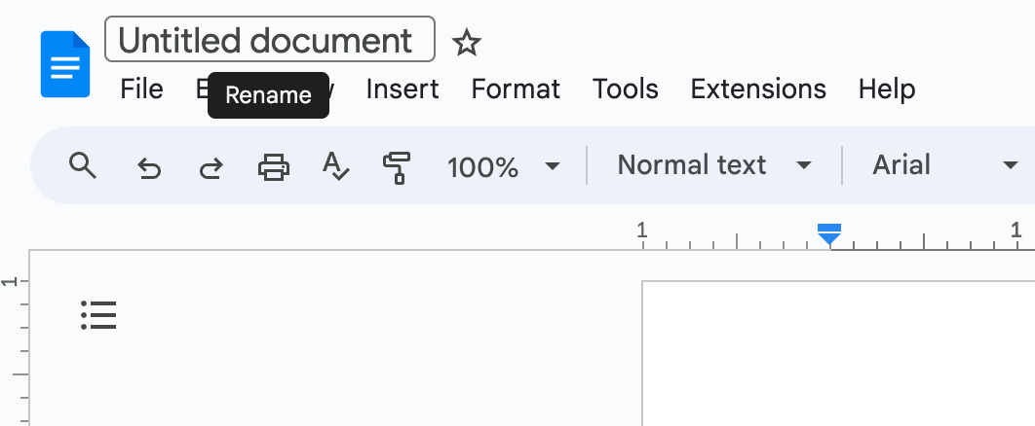
Document title in Google Docs & Slides
Add Document Title In the upper left text field

Slide 55

Document title in Canva
Add Document Title in the relevant field in the document editor’s menubar

Slide 56
Technique #7: Results after Export
In Microsoft Word and PowerPoint (desktop):
  The document title is passed to the PDF as expected.
In Word and PowerPoint for the Web:
  The file name (i.e., <title>) is not passed to the PDF as the document title (as would appear in Document Properties).
  Author is passed to the PDF.
In Google Docs:
  The document title is passed to the PDF as expected.
In Canva:
  The document title is passed to the PDF as expected.

Slide 57
Technique #8
Language

Slide 58
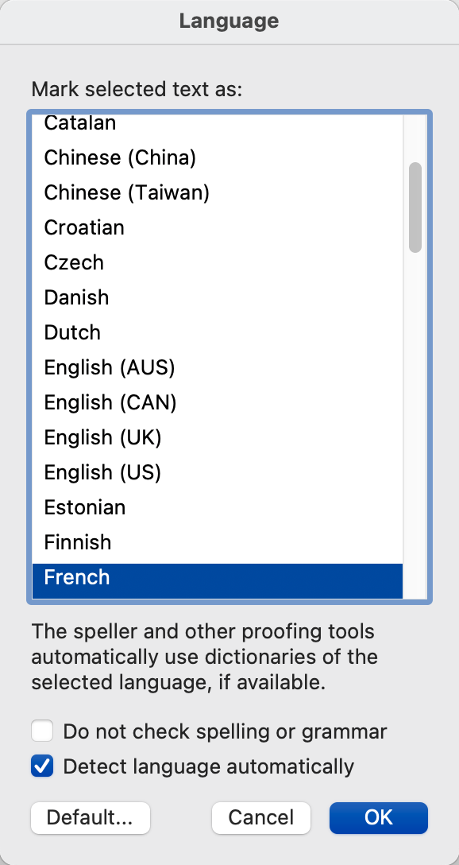
Language in Word and PowerPoint
To set the document language:
  From the Review tab select “Language”
    In Word for Web, choose Editor then set proofing language
  Choose proper language from the list
To set ”language of parts”:
  Select the foreign language text
  Repeat the above process
It is not currently possible to assign language in:
  PowerPoint for the Web

Slide 59
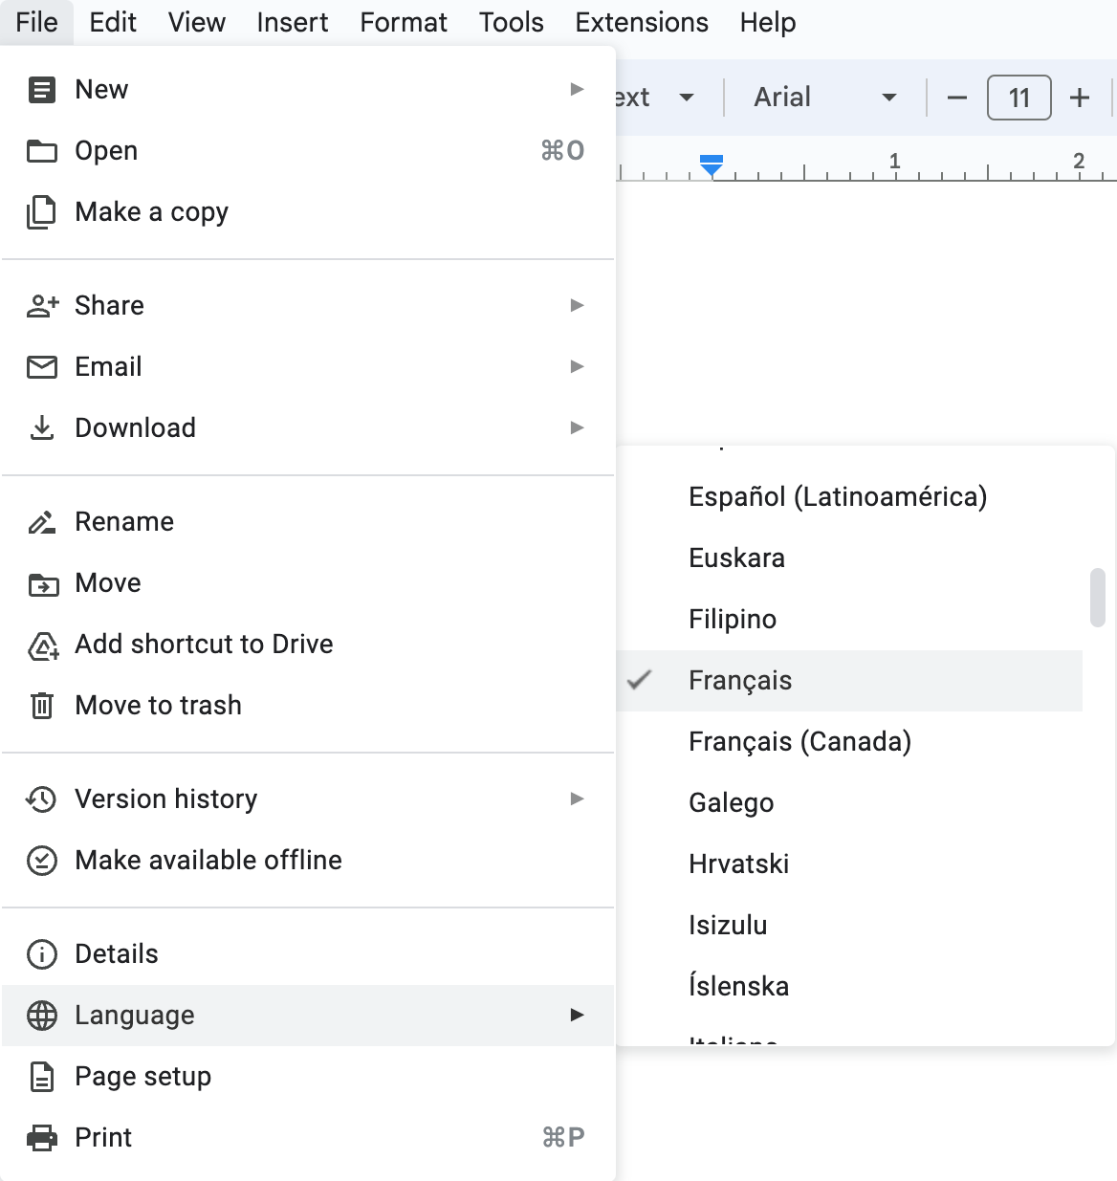
Language in Google Docs & Slides
From the File menu choose "Language”
It is not possible to set a different language for foreign language parts within a document.

Slide 60
Language in Canva
Language can only be changed for the entire account, in Account Settings.
It is not possible to set a different language for a document or foreign language parts within a document.

Slide 61
Technique #8: Results after Export
Language of the document and language of parts survives the export from Word and PowerPoint to PDF.
Language of the document survives the export from Google Docs or Slides to PDF, but Google does not support defining a separate language of parts.
Since language cannot be set in Canva, there is no language attribute to export.

Slide 62
Technique #9
Read Order

Slide 63
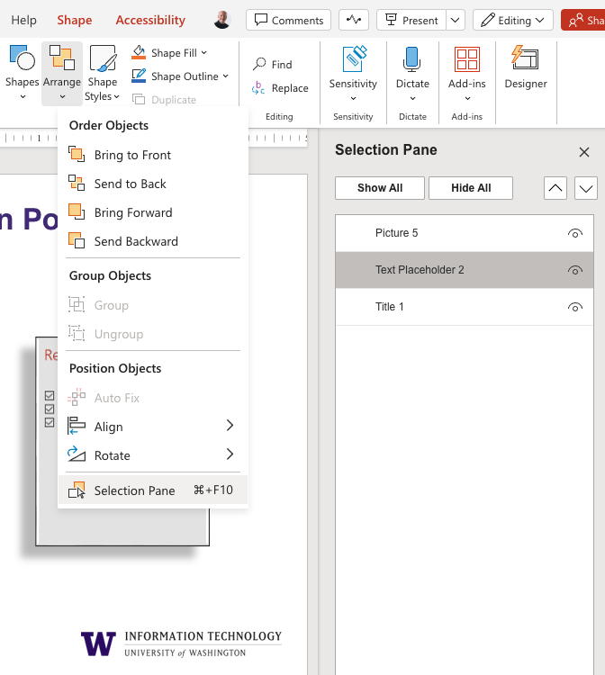
Selection Pane in PowerPoint
Arranged in reverse order, bottom to top
From the Home ribbon
  Select the “Arrange” drop down then “Selection Pane”

Slide 64
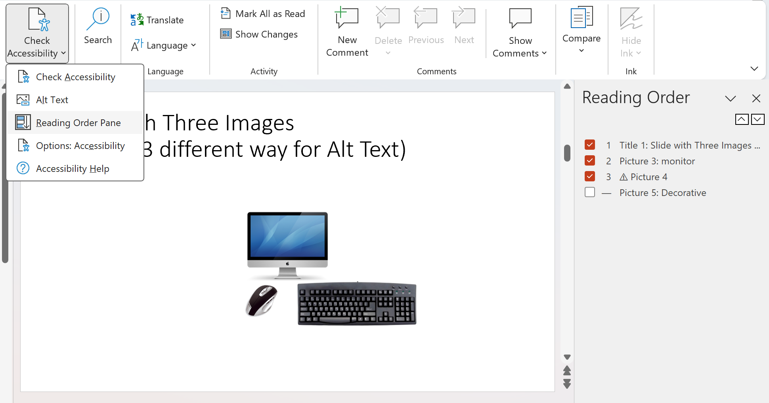
Reading Order Pane in PowerPoint
Arranged top to bottom
From the Review tab
  Select ”Check Accessibility” then “Reading Order Pane”

Slide 65
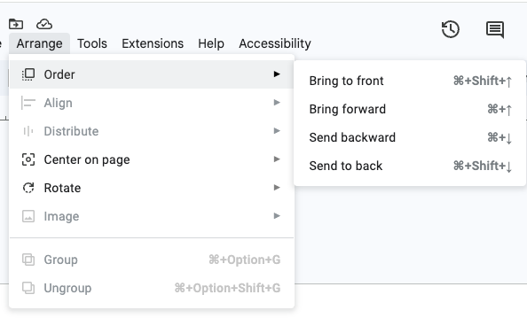
Controlling read order in Google Slides
Content is read from front to back
Content can be rearranged via Arrange > Order.
There is nothing comparable to PowerPoint’s Reading Order or Selection Panes

Slide 66
Controlling read order in Canva
Canva currently provides no means of controlling reading order, but this functionality is coming soon.

Slide 67
Technique #10
Accessibility Checker

Slide 68
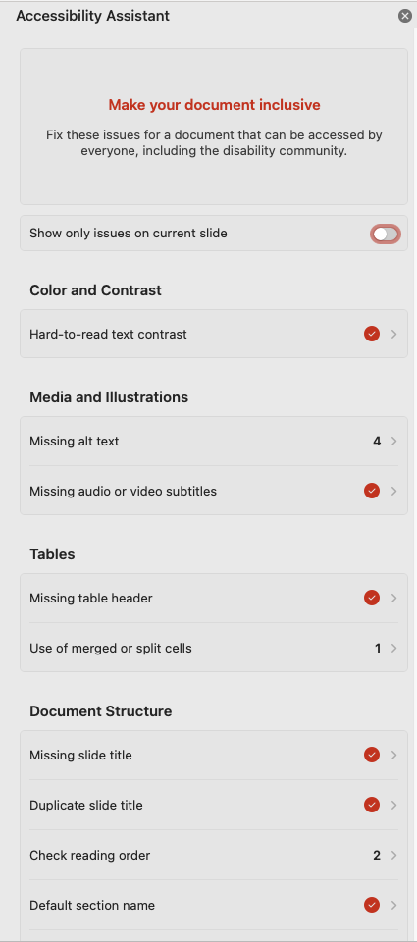
Checking accessibility in Word and PowerPoint
From the Review tab
  Select "Accessibility" from the ribbon
Explanations and Steps to Fix are provided
Checks for:
  Contrast
  Alt text
  Captions on audio/video
  Tables
  Document structure

Slide 69
Checking accessibility in Google Docs & Slides
Google has no accessibility checker.
Grackle fills this gap.

Slide 70
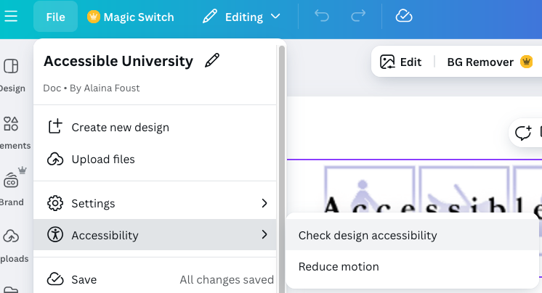
Checking accessibility in Canva
File > Accessibility > Check design accessibility
Checks for text size, color contrast, and alternative text. Provides suggestions to fix issues.

Slide 71
Questions?

